Slide 1
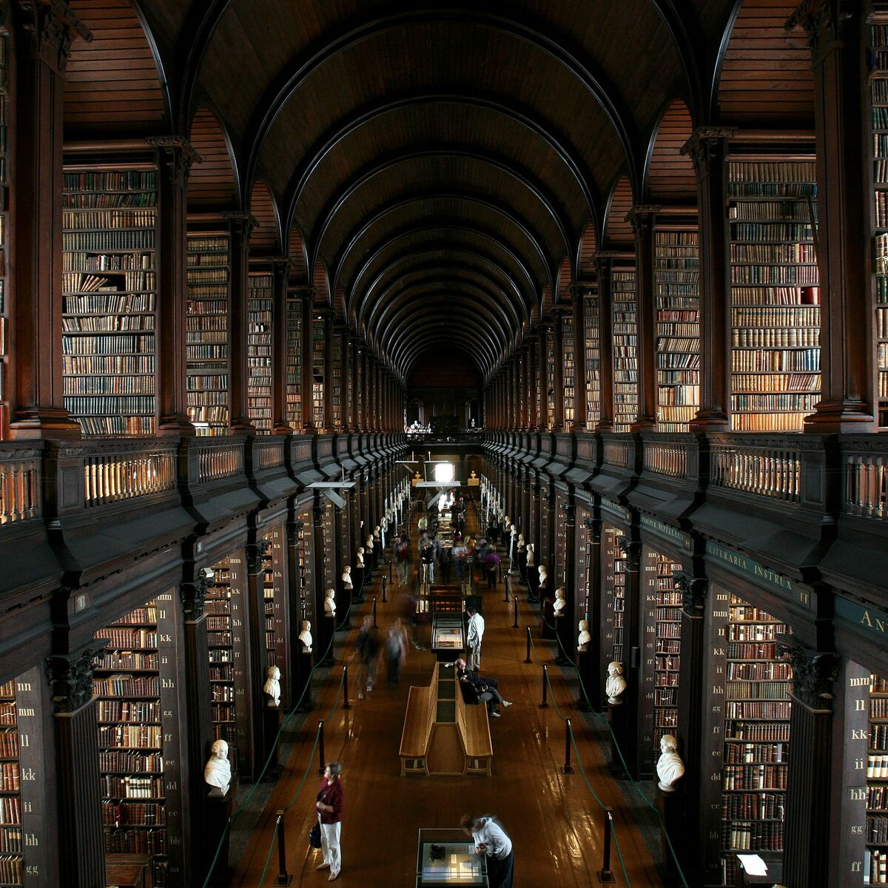
Never Ending Stories
Juhwan Lee
Graham Seamans
Tareq Jallad

Slide 2
The ultimate goal of this project
Showing that using text generation, computers can also generate stories.
Demonstrating that NLG can be used to contribute to the creation of literature works.
This can give some guidance to the author.
This can be used as an assistant or inspiration.
Showing some possibilities that computer generated arts can be respected as well.

Slide 3
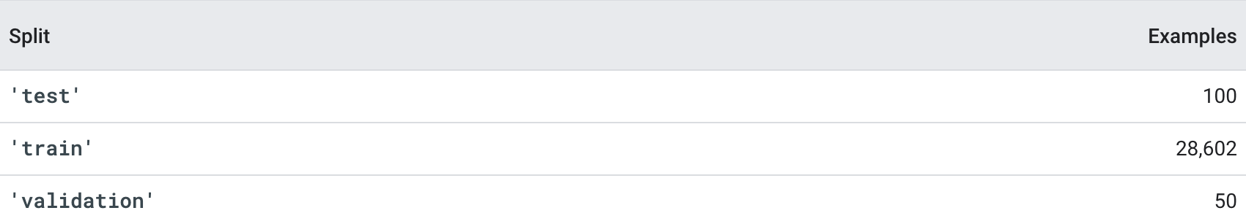
PG-19 Dataset
It includes a set of books extracted from the Project Gutenberg books project (https://www.gutenberg.org), that were published before 1919.
Books are partitioned into a train, validation, and test set.

Slide 4
GPT-2 Language Model
Since our ultimate goal is text generation, we decided that it is more preferable to perform fine-tuning using the PG-19 dataset on a pre-trained language model rather than creating and training a completely new model.
GPT2 conducts pre-learning using texts in various areas. This allows the model to understand text in a wider variety of contexts and domains.
Therefore, if we fine-tune the GPT-2 model with the PG-19 Dataset, we will be able to generate texts that are stories.

Slide 5
T5 Summarizer
Our program does one additional task before fine-tuning GPT-2 with the PG-19 Dataset. It is to create a summary of the text preceding where we generate from.
So, our program uses summary when generating text to increase the understanding of the context and then guesses the next word, and it will show the difference in the result with and without summary.

Slide 6
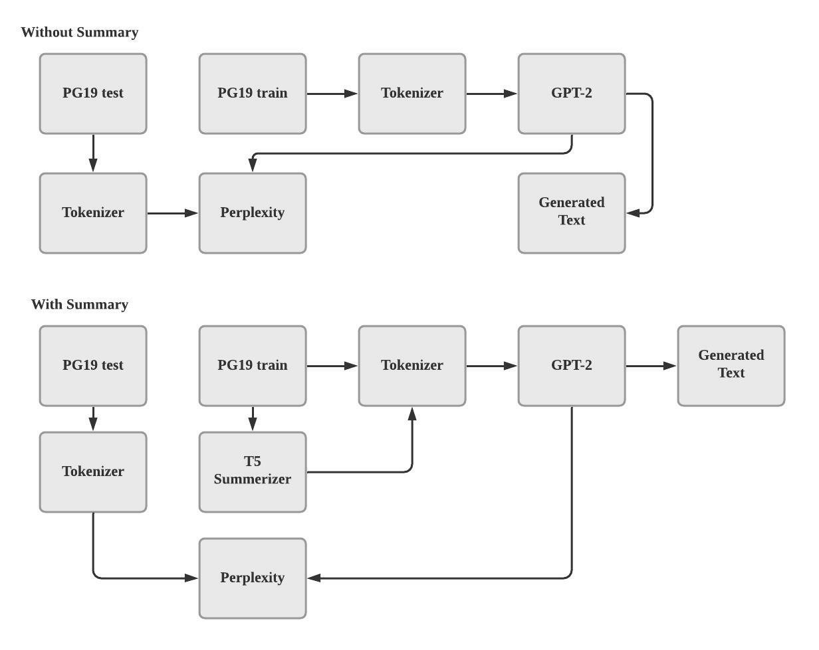
Pipeline
We have two scenarios. One is when summarizer is used, and the other is when summarizer is not used. We will then compare the perplexity and generated text of the two scenarios.

Slide 7
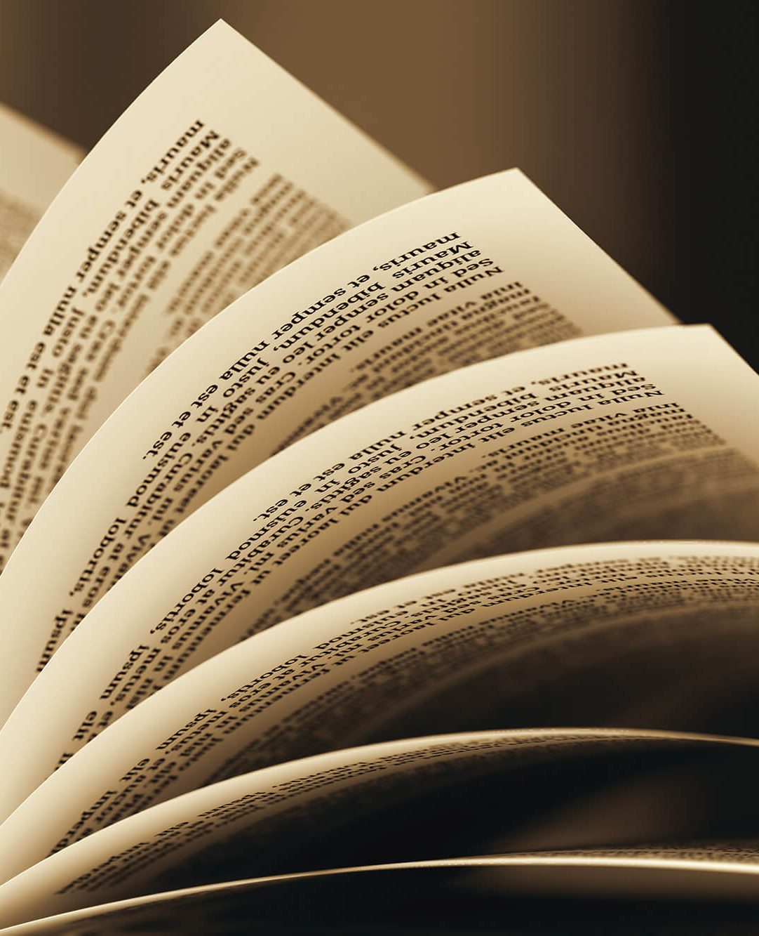
Before Fine-Tuning
The king marvelled much at her silence, and presently repeated his questions, adding, "And what do you carry so carefully in those two sacks, which seem over-heavy for your delicate shoulders?" Still holding her eyes downcast, the princess took a ruby from one bag, and a sapphire from the other, and in silence handed them to the king, for she willed that he should know she was no beggar, even though her shoes were dusty. Thereat all the nobles were filled with amazement, for no such gems had ever been seen in that country. But the king looked steadfastly at the princess, and said, "Rubies are fine, and sapphires are fair; but, maiden, if I could but see those eyes of yours, I warrant that the gems would look pale and dull beside them." At that the princess raised her clear dark eyes, and looked at the king and smiled; and the glance of her eyes pierced straight to his heart, so that he fell on his knees and cried: "Ah! sweet princess, now do I know that thou art the love
of the King. I am so glad that thou art so dear to me. I wish to be king until thou canst be queen. Now, my sweet heart, if I could only see the crown with my own eyes, I could not be mad; for I would have never asked thee to be my wife to you. I would have made thee a queen; and I would have made thee a queen if thou were my own wife." The king and the princess were delighted to hear the king's furious cry, and when they saw this, they both rose. "Princess!" exclaimed the king, "what did thou say, and how will thou do me no harm?" "I never said that," replied the princess, "for thou made me such a great hope and such a great desire that I could never see thee again. I would have never tried to see thee again, and yet thou were so far from seeing me that I could not see thee any more of thee. If thou didst seek the King to give me my crown, I would have loved thee well

Slide 8
Fine-Tuning Without Summary
The king marvelled much at her silence, and presently repeated his questions, adding, "And what do you carry so carefully in those two sacks, which seem over-heavy for your delicate shoulders?" Still holding her eyes downcast, the princess took a ruby from one bag, and a sapphire from the other, and in silence handed them to the king, for she willed that he should know she was no beggar, even though her shoes were dusty. Thereat all the nobles were filled with amazement, for no such gems had ever been seen in that country. But the king looked steadfastly at the princess, and said, "Rubies are fine, and sapphires are fair; but, maiden, if I could but see those eyes of yours, I warrant that the gems would look pale and dull beside them." At that the princess raised her clear dark eyes, and looked at the king and smiled; and the glance of her eyes pierced straight to his heart, so that he fell on his knees and cried: "Ah! sweet princess, now do I know that thou art the love
of man, and I believe that thou art the love of the kingdom, and, with me, that thou mayest bear me! I have only one love, that is, that which shall be always with thee." When the King heard this, he said, "Oh, sweet princess, we have sworn to keep thee for ever, and we shall never forget that thou art my beloved." And the princess, in her tears, said, "I will never forget that thou art my love. Thou art my love, and I love thee. Thy love is the love of the kingdom." Then she said, "Yes, I promise to keep thee. Thy love is the love of the kingdom. Do thou not believe in it myself, and believe in every one that has it, that I have ever given it to thee." And the king smiled as if he was happy. And, as he spoke, his eyes grew wide, and he said: "And now, O king, I will never forget that thou art my love, and that thou art my wicked love. Thou art my love, and I love thee. Thou art my love, and I love thee

Slide 9
Fine-Tuning With Summary
by dale and by down, through moss and through meadow, and by-and-by a fair high palace, built all of marble and shining jasper, and with two bags of gems hung upon her shoulders, fared forward with a light heart, by dale and by down, through moss and through meadow. The princess, standing alone at his palace-gate, took a ruby from one bag, and a sapphire from the other, and in silence handed them had ever been seen in that country. But the king looked steadfastly at the princess, and said, "Rubies are fine, and sapphires are fair; but, maiden, if I could but see those eyes of yours, I warrant that the gems would look pale and dull beside them." At that the princess raised her clear dark eyes, and looked at the king and smiled; and the glance of her eyes pierced straight to his heart, so that he fell on his knees and cried: "Ah! sweet princess, now do I know that thou art the love
of the world?" Then, before her eyes she stretched out her hands, and said, "I know that the gems will look pale and dull without me, and without all those eyes of mine, and without all those eyes of mine!" The king looked at her in amazement, and said, "I know what I cannot do, but, and I know the gems will look pale and dull; and I know the gems will look pale and dull with me without thee, even without thee, and without all those eyes of mine." And the princess opened her eyes and said, "My heart never can begin to grow faint. But I must trust in thy love and love and the love of the world, because thou art the love and love of the princess. I am not weary, my heart, and I am not weary; but I fear that I cannot be weary and my heart with thee; and I fear that I cannot be weary and my heart with thee. The ruby and the sapphire are a fine gem, and I can see them, and it is very hard to see them, and I am not doubtful it will not be as she thinks; but the sapp

Slide 10
Perplexity
Fine-Tuning Without Summary:
100%|██████████| 41342/41342 [43:25<00:00, 15.86it/s]
Perplexity: 25.040941238
Fine-Tuning With Summary:
100%|██████████| 9082/9082 [02:19<00:00, 65.20it/s]
Perplexity: 29.832622528076172
Calculating perplexity is tricky because we're changing our input to the model, so take these numbers lightly. We're still working out how to do perplexity properly.

Slide 11
Faced Challenges
Figuring out what is the right model and what is the right summarizer was challenging.
Since the PG-19 Dataset is massive (about 11GB), figuring out how to load the data properly was difficult.
Finding out whether to put the summarizer in the model or in the data loader was another challenge.
Finally, because the amount of data is huge, training the model took so long and sometimes we experienced runtime disconnect while training.

Slide 12
Future Extension
Trying using summarizer in the model might help improve the performance.
Our current program is fine-tuned on the PG-19 Dataset which is a set of books that were published before 1919 but if the user wants to generate text in a specific author’s style, fine-tuning on a specific author’s literature works can do it. For example, tasks such as creating fake Shakespeare plays will be possible.
For evaluation, currently our program only uses single word perplexity but if more evaluation methods are added, it would help to better measure if the language model is good or not.

Slide 13
Thank You

